Slide 1
Ethyl
Wearable Tech for
Alcohol Addiction Recovery
By Chris Blackwood, Sharan Juangphanich, and Ryan O’Shea

Slide 2


Alcoholism is rampant
17+ Million Americans abuse alcohol
10% of US children have a parent with alcohol problems

Slide 3
Current treatment is ineffective in the long term
Notes:
40-60% relapse rate with standard treatment
At home, no structured environment to make sure they’re staying clean

Slide 4
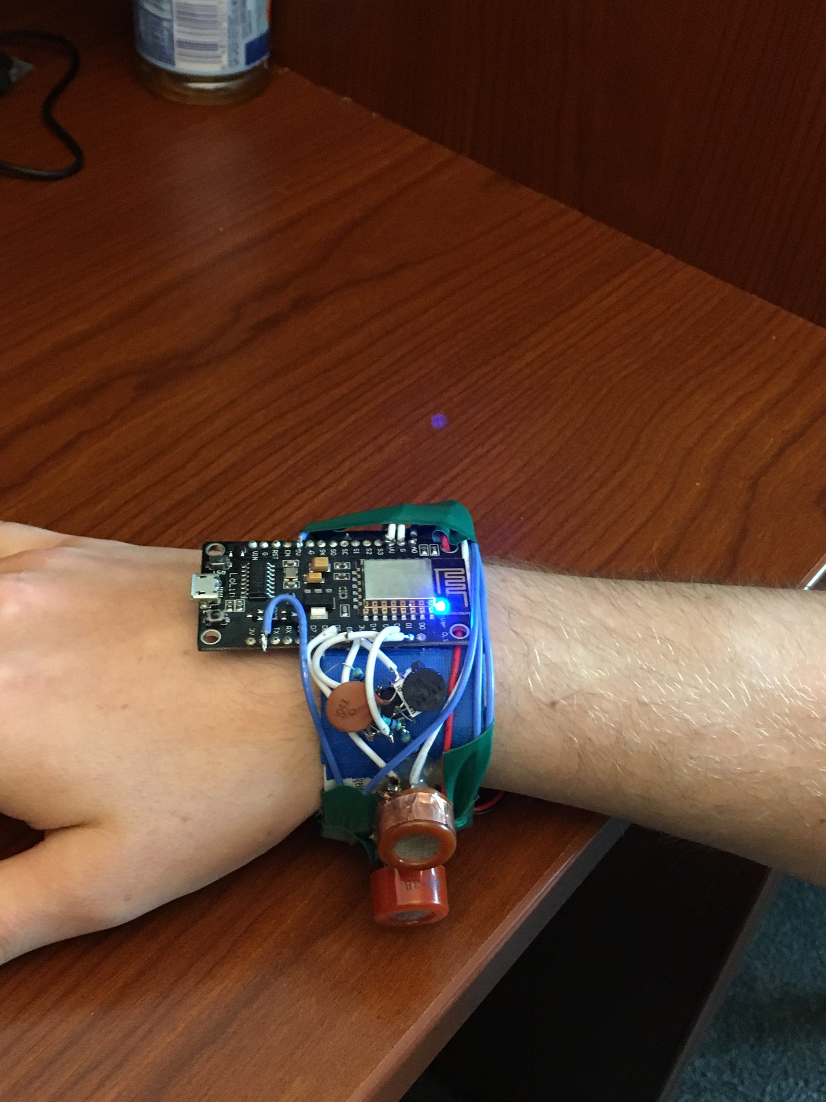
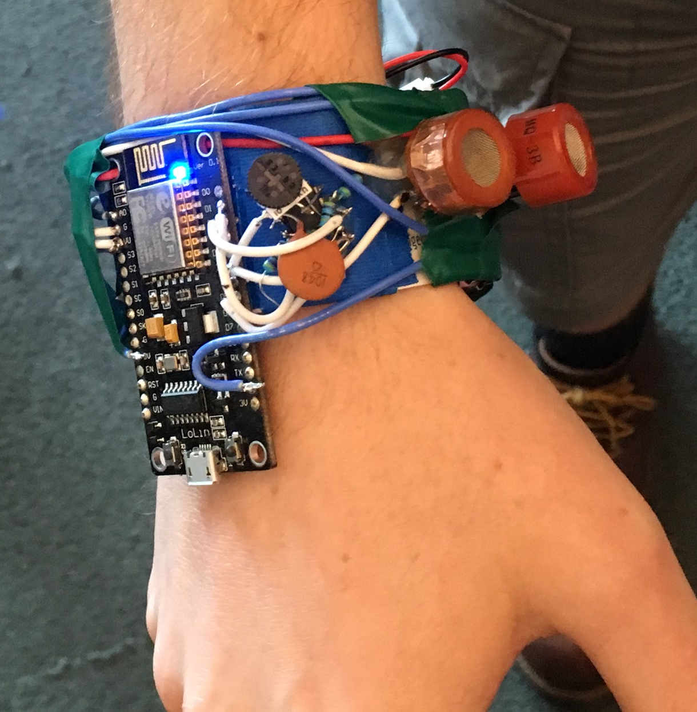

Slide 5
Production Tech Specs
Estimated BOM Cost
Silicon Labs Bluetooth LE 5.0 Module | $4
Transdermal Alcohol Contact Sensor | $0.15
Transdermal Contact Sensor | $0.15
Sensirion Multi-pixel VOC Sensor | $0.80
Lithium Ion Battery | $1.50
Misc RBOM | $3
Mechanicals | $5
Total | $14.60
Certifications
UL Certified (Medical and consumer)
FCC Certified (BLE 5.0)
Weatherproof
IP65 Rating
Conformal Coated
Rechargeable Battery
CR2032
Fast charge (USB BC1.2)

Slide 6
Business Model
Target Consumer
Family members with recovering alcoholics
Recovering alcoholics
Insurance companies
Focus on growth before being cash flow positive
Sell device at low cost of $30
Built-in subscription model
Access to community of support
Access to healthcare professionals
Access to monitoring solution

Slide 7
ADDENDUM

Slide 8
Competitive Analysis
BACtrack SKYN
Wearable device that tracks BAC and displays it to the wearer
Only being used to track BAC for drinkers and not as a recovery solution

Slide 9
MVP Tech Specs
Alcohol Sensor ($2)
Contact Sensors ($0.15)
ESP8266 ($1)
Lithium Battery ($0.85)
Misc RBOM ($2)
Misc Mechanicals (Free)
Total Cost: $6

